Slide 1



Introduction to Twitter Sentiment Analysis
Explore the power of understanding public sentiment on the world's most influential social media platform. Twitter sentiment analysis unlocks insights into how users perceive brands, events, and trends, enabling data-driven decision making.
by B. FARUQ HUSSAIN

Slide 2
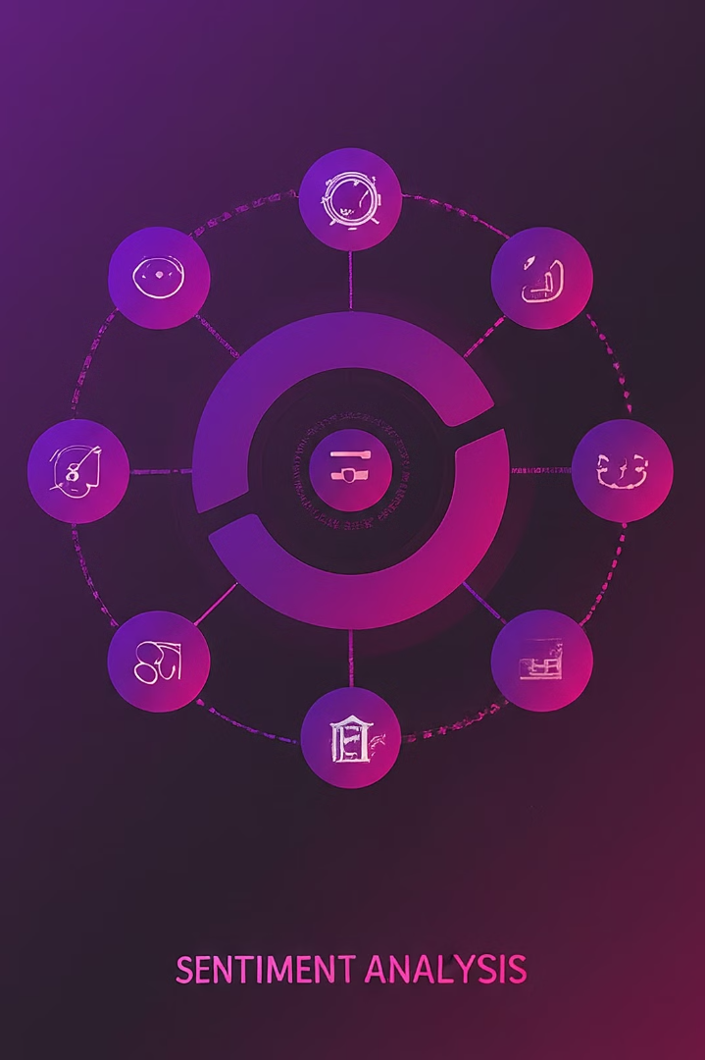
Table of Contents
Problem Statement
Data Collection and Preprocessing
Visualization of Sentiment Distribution
Tools and Technologies
Model Building and Testing
Real-Time Applications for Twitter Analysis
Conclusion
Future Scope

Slide 3

Problem Statement
With the rapid growth of social media platforms like Twitter, there is a vast amount of user-generated content expressing opinions and sentiments on various topics. Analyzing this data manually is time-consuming and often impractical. Therefore, there is a need for automated sentiment analysis tools that can process and categorize tweets based on their sentiment (positive, negative, or neutral) towards specific subjects.

Slide 4

Data Collection and Preprocessing
Acquire Twitter data via APIs or public datasets, ensuring representativeness and compliance with platform policies.
Clean and preprocess the data, handling missing values, removing noise, and normalizing text to prepare for analysis.
Implement robust data filtering and feature extraction techniques to identify relevant signals and sentiment-bearing keywords.

Slide 5

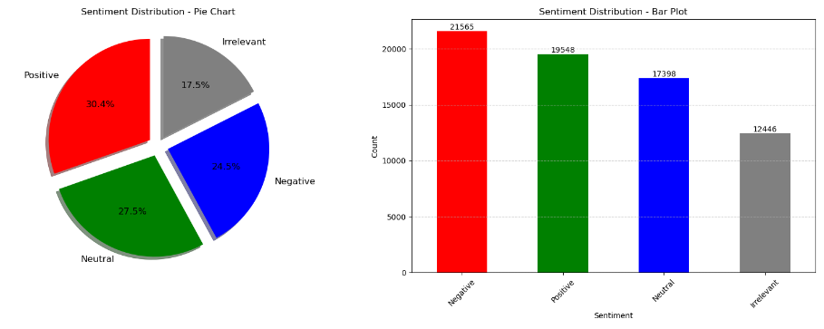
Visualization

Slide 6
Tools and Technologies
Programming Languages: Python for coding flexibility and extensive ML libraries.
Libraries: NLTK, Scikit-Learn, Pandas, NumPy for NLP and data processing. \
Twitter API: Access Twitter data for analysis.
Feature Extraction: TF-IDF, Word2Vec, GloVe for text-to-numbers conversion. Machine Learning Algorithms: SVM, Random Forest Classifier ,Decision Tree

Slide 7
Feature Engineering and Model Selection – Model Building
Feature Engineering
Model Tuning
Deep Learning Models
Ensemble Methods
Experiment with a variety of supervised learning models, such as logistic regression, support vector machines, and ensemble methods. Optimize hyperparameters to achieve the best performance on validation datasets.
Carefully select and engineer relevant features from the Twitter data to capture sentiment-bearing signals. This may involve extracting linguistic, social, and contextual attributes that influence sentiment expression.
Leverage the power of deep neural networks, like LSTM and Transformer-based architectures, to capture complex semantic and contextual relationships in the Twitter text data for more accurate sentiment classification.
Combine multiple sentiment analysis models through techniques like majority voting or stacking to improve overall accuracy and robustness, leveraging the strengths of different approaches.

Slide 8
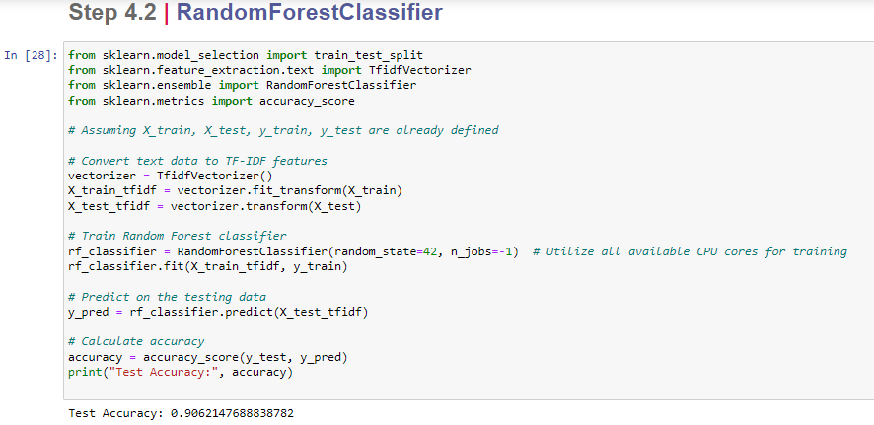

Slide 9

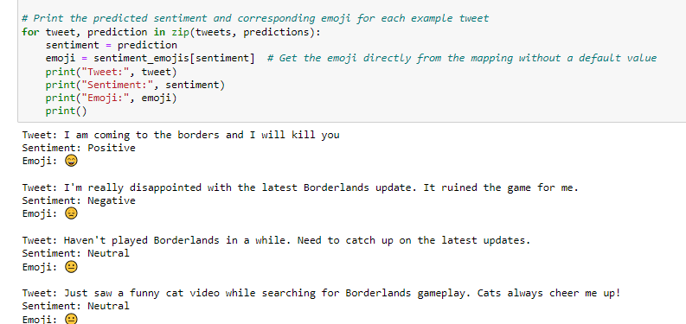

Slide 10

Risk and Challenges
Data Quality: Ensuring accurate and representative Twitter data for reliable sentiment analysis. Model Optimization: Optimizing machine learning models for accurate sentiment classification. Overfitting Risk: Avoiding overfitting to ensure generalization to new tweets. Ethical Considerations: Addressing privacy, bias, and responsible data handling in sentiment analysis.
Interpretability: Ensuring model interpretability for transparent results.
Regulatory Compliance: Adhering to data privacy regulations and standards during analysis

Slide 11




Real-World Applications of Twitter Sentiment Analysis
Business Intelligence
Political Insights
Crisis Communication
Marketing Optimization
Understand public sentiment towards political figures, campaigns, and policies by monitoring and analyzing Twitter conversations, empowering data-driven governance.
Leverage Twitter sentiment analysis to gain real-time insights into customer perceptions, brand reputation, and emerging market trends, informing strategic decision-making.
Leverage Twitter sentiment analysis to quickly identify and address customer concerns, manage brand reputation, and coordinate appropriate crisis response strategies.
Optimize marketing campaigns and product launches by monitoring Twitter sentiment, adjusting messaging, and identifying potential areas of improvement.

Slide 12
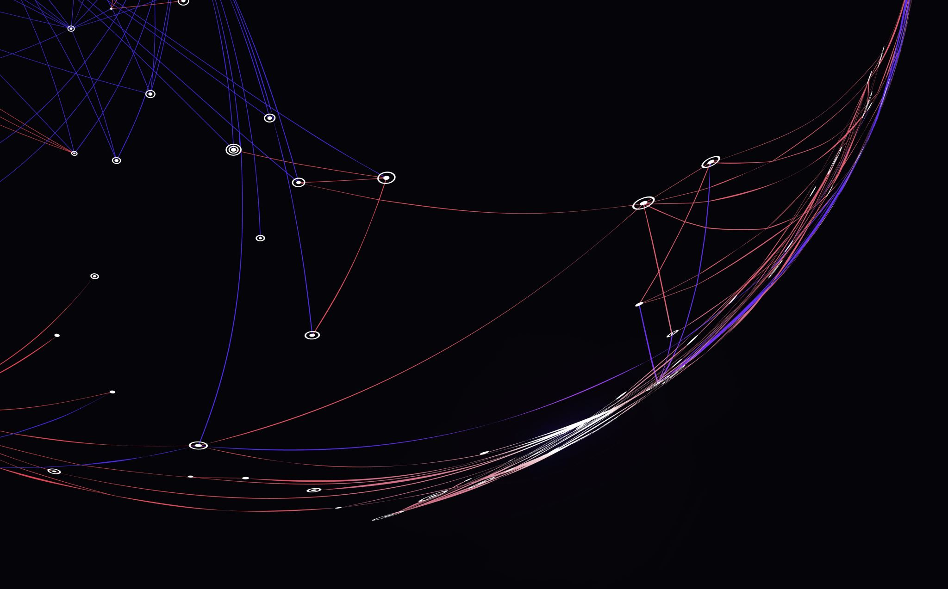
Conclusion
In conclusion, conducting Twitter sentiment analysis using machine learning presents both opportunities and challenges. By addressing data quality, optimizing models, mitigating overfitting, handling deployment complexities, addressing ethical considerations, ensuring interpretability, and complying with regulations, we can unlock valuable insights from Twitter data. Despite the risks involved, the potential benefits in understanding public sentiment and making informed decisions make this endeavor worthwhile.

Slide 13



The Future of Twitter Sentiment Analysis
Ethical AI
1
Responsible development of sentiment analysis models that respect user privacy and promote digital wellbeing.
Multimodal Insights
2
Integrating text, audio, and visual data for a more holistic understanding of online sentiment.
Contextual Understanding
3
Leveraging advancements in natural language processing to capture nuanced, culturally-aware sentiment analysis.
As Twitter sentiment analysis continues to evolve, the future holds exciting possibilities. Ethical AI frameworks will ensure these powerful insights are developed and deployed responsibly. Multimodal data integration and contextual understanding will unlock deeper, more nuanced sentiment analysis, empowering organizations to make data-driven decisions that truly resonate with their audiences.

